Slide 1


INTERNATIONAL CONFERENCE ON SUSTAINABLE TECHNOLOGIES FOR INDUSTRY 4.0
Paper Id: 150
Title: Improvement in Hyperspectral Image Classification by Using Hybrid Subspace Detection Technique
Supervised By
Sadia Zaman Mishu
Lecturer
Dept. of CSE
RUET
Authors
Arifa Islam Champa
Dept. of CSE
IUT
Gazipur
Md. Fazle Rabbi
Dept. of CSE
BAIUST
Comilla
Nayan Banik
Dept. of CSE
Comilla University Cumilla
Notes:
Give a brief overview of the presentation. Describe the major focus of the presentation and why it is important.
Introduce each of the major topics.
To provide a road map for the audience, you can repeat this Overview slide throughout the presentation, highlighting the particular topic you will discuss next.

Slide 2
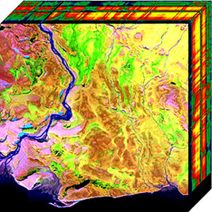
Introduction
Hyperspectral Images:
Collects and processes information across the electromagnetic spectrum where certain objects leave unique 'fingerprints‘
Spectral signatures enable identification of the materials
Figure 1: Two Dimensional Projection of Hyperspectral Cube[1]
Notes:
What will the audience be able to do after this training is complete? Briefly describe each objective how the audience will benefit from this presentation.

Slide 3
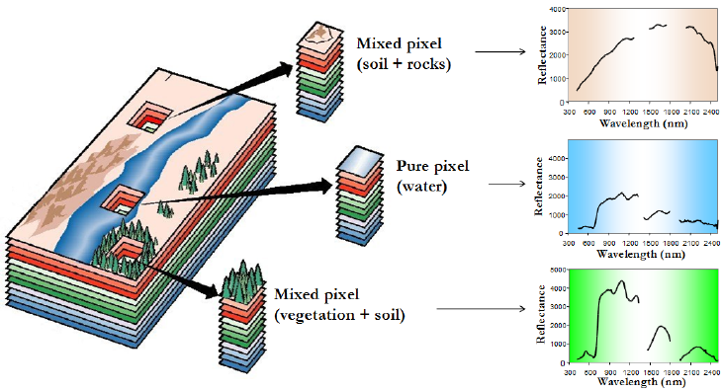
Motivation
Applications in astronomy, agriculture, biomedical imaging, geosciences, physics, surveillance, eye care, food processing, mineralogy, chemical imaging etc
Widely used for ground cover classification problems
Figure 2: Mixture problem in hyperspectral data analysis[2]
Notes:
What will the audience be able to do after this training is complete? Briefly describe each objective how the audience will benefit from this presentation.

Slide 4
Objectives
Extract only relevant features
Select most informative features
Evaluate efficient subspace detection technique
Notes:
What will the audience be able to do after this training is complete? Briefly describe each objective how the audience will benefit from this presentation.

Slide 5
Related Works
[1] M. Ali Hossain , M. Pickering, X. Jia , ”Unsupervised feature extraction based on mutual information measure for hyperspectral image classification” , IEEE International Geoscience and Remote Sensing Symposium(IGARSS) ,978-1-4577-1005-6,2011 [3].
Contributions:
Combined Mutual Information with PCA
Obtained 80% classification accuracy
Limitation:
Only for 10 features for test data
Notes:
What will the audience be able to do after this training is complete? Briefly describe each objective how the audience will benefit from this presentation.

Slide 6
Related Works
[2]M. Ali Hossain, X. Jia, M. Pickering, ”Subspace detection using a mutual information measure for hyperspectral image classiﬁcation ”, IEEE Geoscience and Remote Sensing Letters , vol. 11, no. 2, Feb. 2014 [4].
Contributions:
Combined normalized Mutual Information with PCA
Obtained 96% classification accuracy
Limitations:
Good for a limited number of training samples
Fixed threshold value
Notes:
What will the audience be able to do after this training is complete? Briefly describe each objective how the audience will benefit from this presentation.

Slide 7
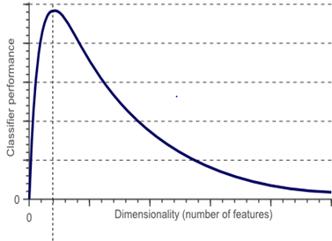
Background Study
Hughes Phenomenon:
If the size of the training data does not grow correspondingly with increment of feature space dimension, then classiﬁcation accuracy reduces
Also known as curse of dimensionality
Feature reduction to mitigate
Figure 3: Hughes Phenomenon [5]
Notes:
What will the audience be able to do after this training is complete? Briefly describe each objective how the audience will benefit from this presentation.

Slide 8
Background Study
Subspace Detection:
High dimensional dataset transformed into low dimensional space
Done in two ways:
Feature Extraction:
Creates new features based on transformations of original feature set
Feature Selection:
Selects best subset of the original feature set
Notes:
What will the audience be able to do after this training is complete? Briefly describe each objective how the audience will benefit from this presentation.

Slide 9
Methodology
Input Hyperspectral Image
Feature Extraction Using PCA
Feature Selection using n-MI
Classification Using KSVM
Figure 4: Flow chart of methodology
Notes:
What will the audience be able to do after this training is complete? Briefly describe each objective how the audience will benefit from this presentation.

Slide 10
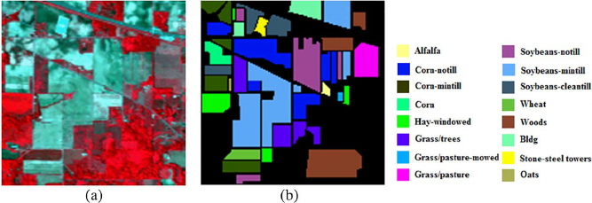
Implementationeote Sensing Data for Analysis
Remote Sensing Data
Remote Sensing Data for Analysis
Dataset: AVIRIS 92AV3C
Spectral: 0.4 µm-2.5 µm
Band: 220
Classes:16
Figure 5: AVIRIS 92AV3C Dataset[6] ((a) Ground Truth Image
, (b) RGB Image)
Notes:
What will the audience be able to do after this training is complete? Briefly describe each objective how the audience will benefit from this presentation.

Slide 11
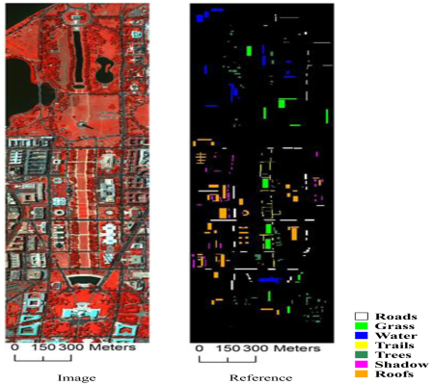
Implementationeote Sensing Data for Analysis
Remote Sensing Data
Remote Sensing Data for Analysis
Dataset: HYDICE DC
Spectral: 0.4 µm-2.4 µm
Band: 191
Classes:7
Figure 6: HYDICE DC Dataset[6]
Notes:
What will the audience be able to do after this training is complete? Briefly describe each objective how the audience will benefit from this presentation.

Slide 12
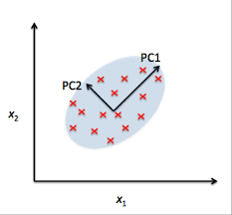
Feature Extraction
Principal Component Analysis(PCA) :
Transforming highly correlated data set into new set of orthogonal uncorrelated variables
Figure 7 : Principal Components[7]
Notes:
What will the audience be able to do after this training is complete? Briefly describe each objective how the audience will benefit from this presentation.

Slide 13
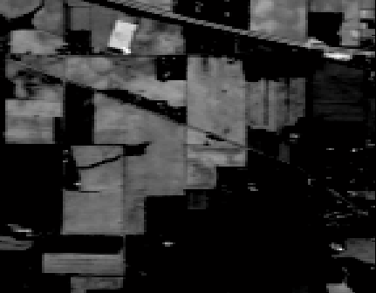
n
Results of PCA
PC1
PC7
PC9
Figure 8 : Principal Components of AVIRIS Data
Notes:
What will the audience be able to do after this training is complete? Briefly describe each objective how the audience will benefit from this presentation.

Slide 14
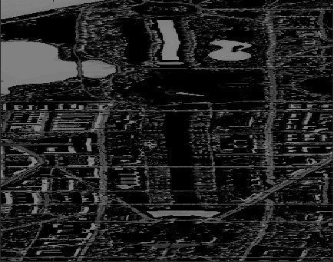
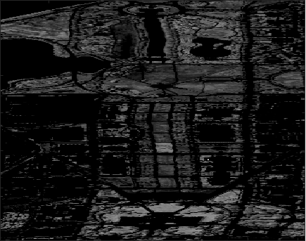

n
Results of PCA
PC1
PC2
PC3
Figure 9 : Principal Components of HYDICE DC Data
Notes:
What will the audience be able to do after this training is complete? Briefly describe each objective how the audience will benefit from this presentation.

Slide 15
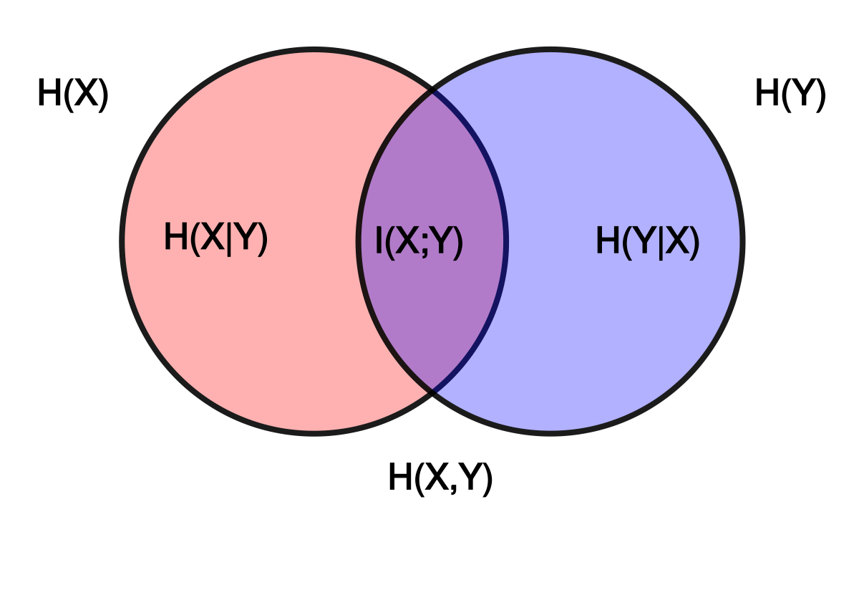
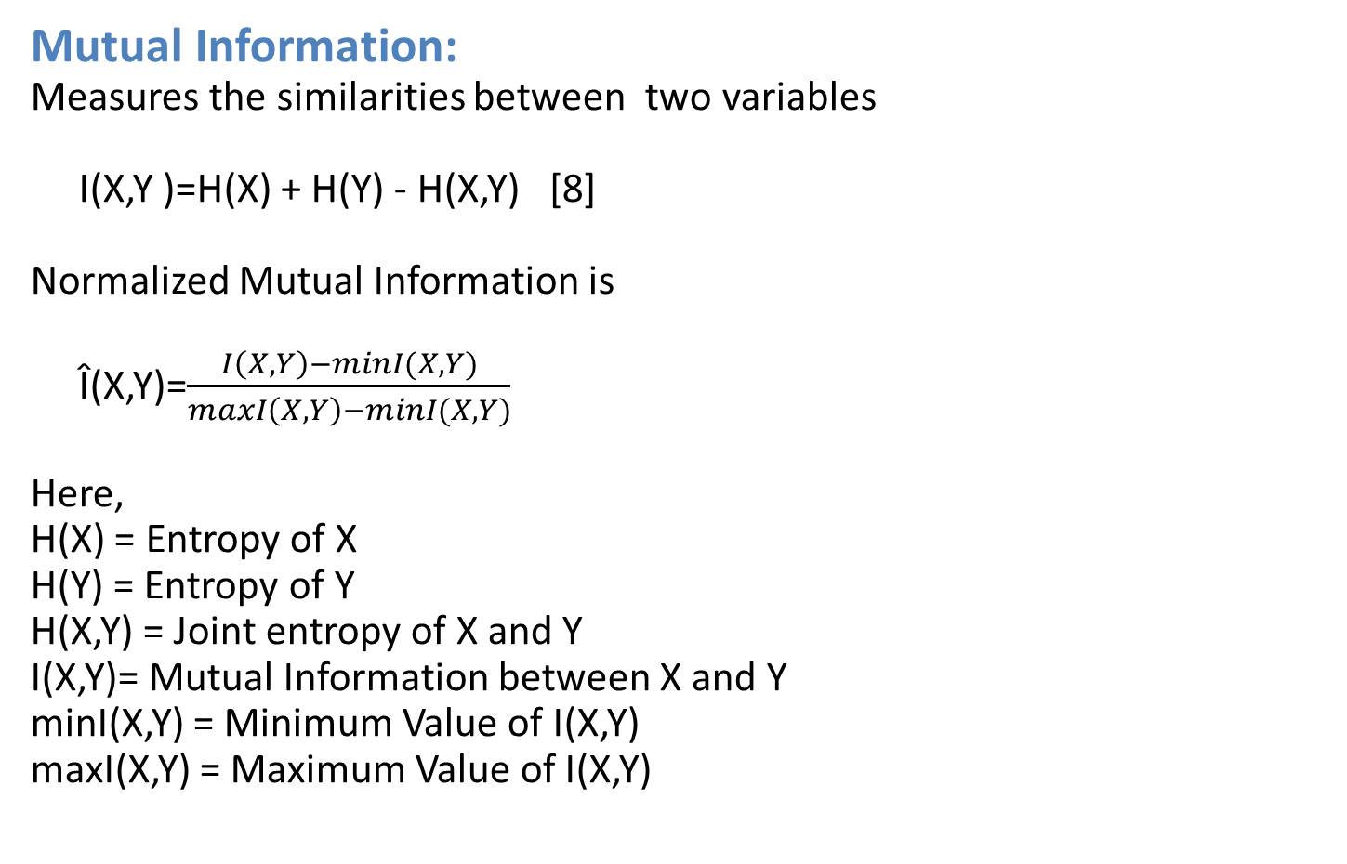
Feature Selection
Mutual Information:
Measures the similarities between two variables
I(X,Y )=H(X) + H(Y) - H(X,Y) [8]
Normalized Mutual Information is
Î(X,Y)=$\frac{I\left(X,Y\right)−minI(X,Y)}{maxI\left(X,Y\right)−minI(X,Y)}$
Here,
H(X) = Entropy of X
H(Y) = Entropy of Y
H(X,Y) = Joint entropy of X and Y
I(X,Y)= Mutual Information between X and Y
minI(X,Y) = Minimum Value of I(X,Y)
maxI(X,Y) = Maximum Value of I(X,Y)
Figure 10 : Mutual Information[9]
Notes:
What will the audience be able to do after this training is complete? Briefly describe each objective how the audience will benefit from this presentation.

Slide 16
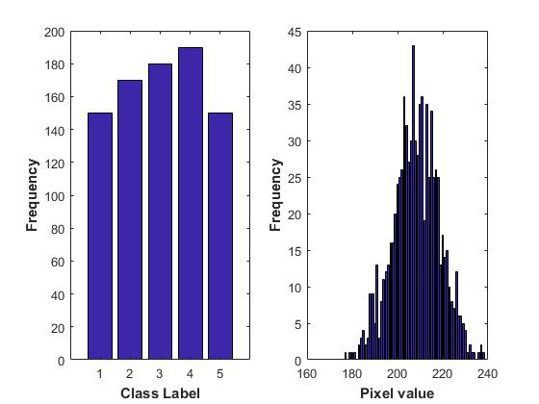
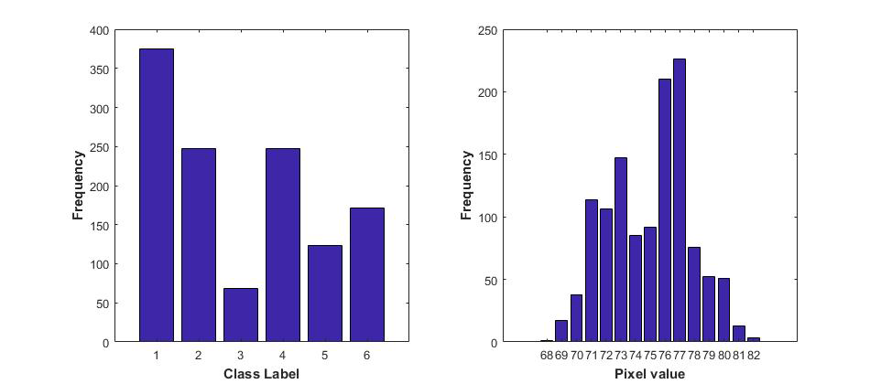
Histogram of Class Labels and Samples
(a)AVIRIS 92AV3C
(b)HYDICE DC
Figure 11 : Class Labels (Left) and sample data histogram(right)
Notes:
What will the audience be able to do after this training is complete? Briefly describe each objective how the audience will benefit from this presentation.

Slide 17
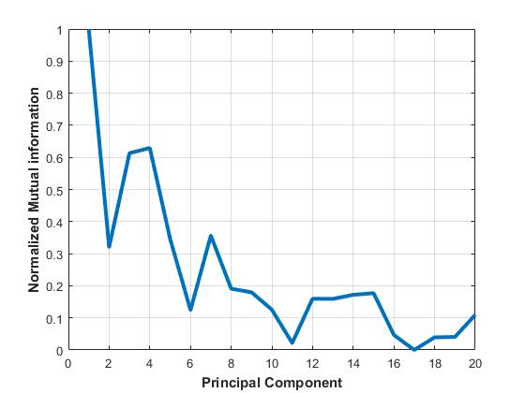
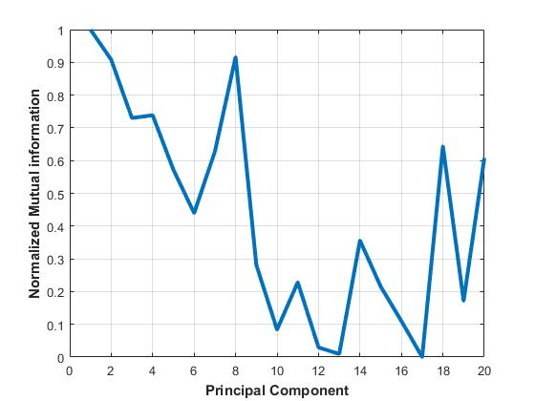
nMI between Class Labels and PCs
(a)AVIRIS 92AV3C
(b)HYDICE DC
Figure 12 : nMI between Class Labels and PCs
Notes:
What will the audience be able to do after this training is complete? Briefly describe each objective how the audience will benefit from this presentation.

Slide 18
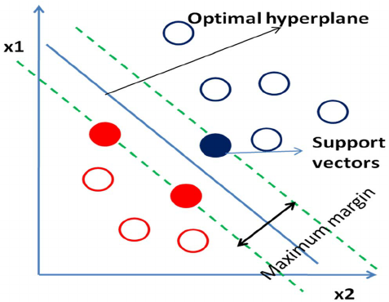
Support Vector Machine (SVM)
Supervised learning method
Used for classification and regression
Classifies complex data sets in higher dimensional space by constructing linear plane
Figure 13 : Representation of Support Vectors [10]
Notes:
What will the audience be able to do after this training is complete? Briefly describe each objective how the audience will benefit from this presentation.

Slide 19
Steps of SVM Classifier
Step 1: Got train and test data
Step 2: Conducted scaling on data
Step 3: Considered the RBF kernel K(x,y) = e^{-ϒ||x-y||2}
Step 4: Used 10-fold Cross validation to find best C and ϒ
Step 5: Used C and ϒ to train whole training set
Step 6: Test
Notes:
What will the audience be able to do after this training is complete? Briefly describe each objective how the audience will benefit from this presentation.

Slide 20
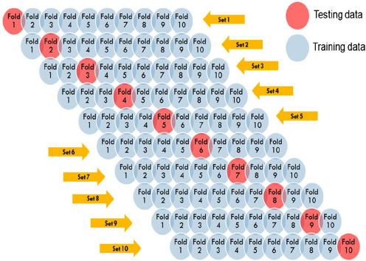
I
Cross Validation
In 10-fold cross validation:
Training set is divided into 10 equal sized sets
1 subset is tested using the classifier trained on the remaining 9 subsets
Figure 14 : 10-fold cross validation [11]
Notes:
What will the audience be able to do after this training is complete? Briefly describe each objective how the audience will benefit from this presentation.

Slide 21
Train and test sample
Table 1 : HYDICE DC Data
Table 2 : AVIRIS 92AV3C Data
Classes | Train | Test
Water | 375 | 204
Streets | 68 | 32
Grass | 247 | 180
Trees | 171 | 130
Roof | 247 | 143
Shadow | 123 | 68
Classes | Train | Test
Corn-notil | 150 | 120
Soybean-min | 170 | 126
Woods | 180 | 169
Soybean-notil | 190 | 152
Hay-windrowed | 150 | 128
Notes:
What will the audience be able to do after this training is complete? Briefly describe each objective how the audience will benefit from this presentation.

Slide 22
Classification Result
Table 3 : Cost and gamma value (AVIRIS)
Table 4 : Cost and gamma value (HYDICE)
Methods | C | ϒ
Actual | 4 | 4
MI | 5 | 3
PCA | 3 | 0
PCA-nMI | 3 | 0
Methods | C | ϒ
Actual | 5 | 6.5
MI | 5 | 7.5
PCA | 5 | 6
PCA-nMI | 3 | 1
Table 5 : Classification result
Methods | AVIRIS | HYDICE DC
Actual | 48.99% | 65.82%
MI | 70.2158% | 96.5654%
PCA | 92.2302% | 99.0753%
PCA-nMI | 97.2662% | 99.2074%
Notes:
What will the audience be able to do after this training is complete? Briefly describe each objective how the audience will benefit from this presentation.

Slide 23
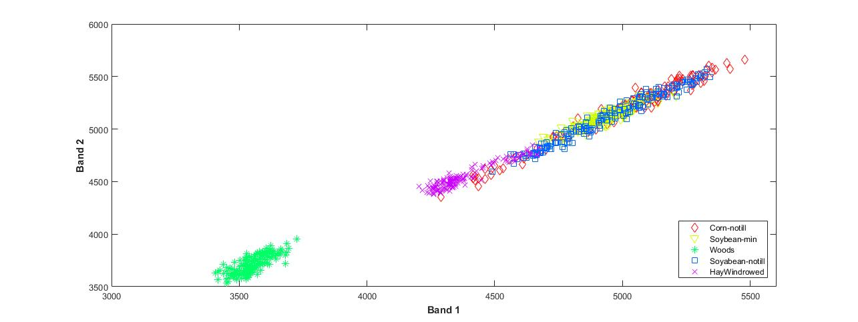
AVIRIS Data Classification Result
Figure 15 : Classification after applying MI
Notes:
What will the audience be able to do after this training is complete? Briefly describe each objective how the audience will benefit from this presentation.

Slide 24
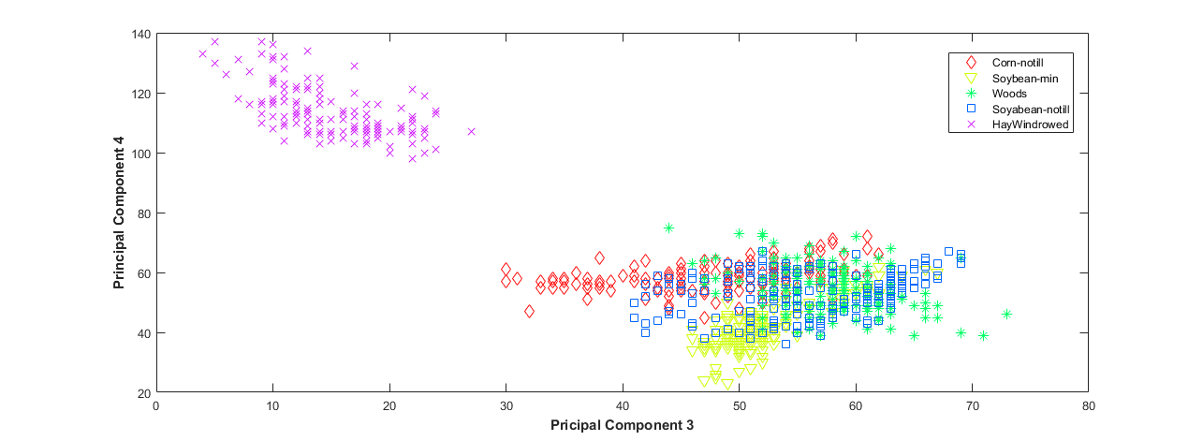
AVIRIS Data Classification Result
Figure 16 : Classification after applying PCA
Notes:
What will the audience be able to do after this training is complete? Briefly describe each objective how the audience will benefit from this presentation.

Slide 25
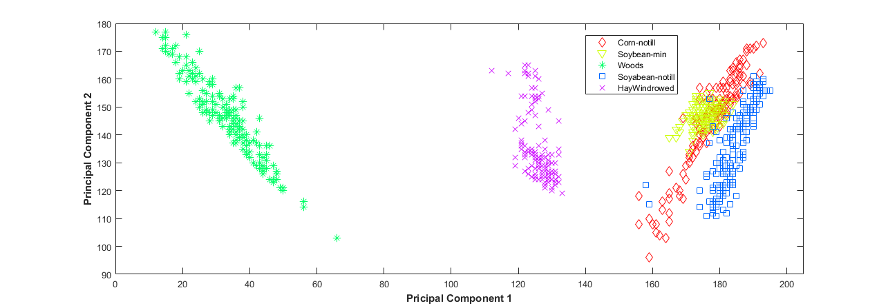
AVIRIS Data Classification Result
Figure 17 : Classification after applying PCA-nMI
Notes:
What will the audience be able to do after this training is complete? Briefly describe each objective how the audience will benefit from this presentation.

Slide 26
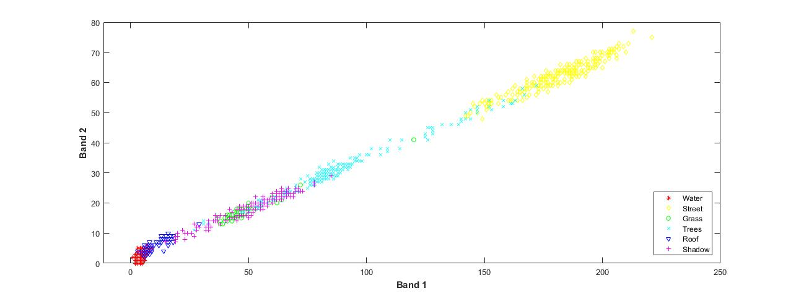
HYDICE Data Classification Result
Figure 18 : Classification after applying MI
Notes:
What will the audience be able to do after this training is complete? Briefly describe each objective how the audience will benefit from this presentation.

Slide 27
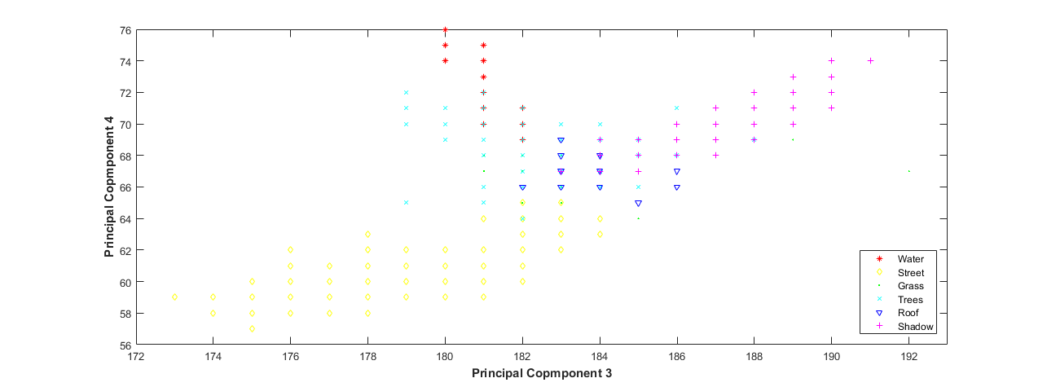
HYDICE Data Classification Result
Figure 19 : Classification after applying PCA
Notes:
What will the audience be able to do after this training is complete? Briefly describe each objective how the audience will benefit from this presentation.

Slide 28
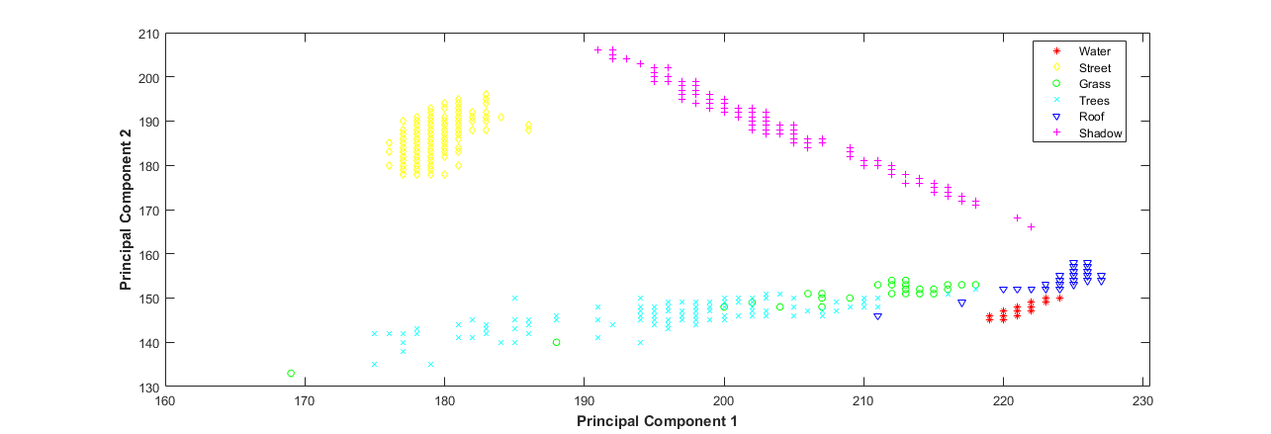
HYDICE Data Classification Result
Figure 20 : Classification after applying PCA-nMI
Notes:
What will the audience be able to do after this training is complete? Briefly describe each objective how the audience will benefit from this presentation.

Slide 29
Conclusion
Future Works:
Feature extraction using Kernel PCA
Feature Selection Using Quadratic Mutual Information
Introducing Adaptive Threshold
Notes:
What will the audience be able to do after this training is complete? Briefly describe each objective how the audience will benefit from this presentation.

Slide 30
References
[1] | “Hyperspectral Image”,https://en.wikipedia.org/wiki/Hyperspectral_imaging/.
[2] | M.Ciznicki K.Kurowski and A.Plaza , “GPU Implementation of JPEG2000 for Hyperspectral Image Compression” Published in SPIE Proceedings, University of Extremadura, Spain, pp.8183 Oct 2011.
[3] | M. A. Hossain , M. Pickering, X. Jia , ”Unsupervised feature extraction based on mutual information measure for hyperspectral image classification” , IEEE International Geoscience and Remote Sensing Symposium(IGARSS) ,978-1-4577-1005-6,2011.
[4] | M. A. Hossain, X. Jia, M. Pickering, ”Subspace detection using a mutual information measure for hyperspectral image classiﬁcation ”, IEEE Geoscience and Remote Sensing Letters , vol. 11, no. 2, Feb. 2014 .
[5] | “The curse of dimensionality in classification,” http://www.visiondummy.com/2014/04/curse-dimensionality-affect-classification/.
[6] | D.A.Landgrebe.“Available:https://engineering.purdue.edu/biehl/MultiSpec/hyperspectral.html”.
Notes:
What will the audience be able to do after this training is complete? Briefly describe each objective how the audience will benefit from this presentation.

Slide 31
References
[7] | “Principal Component Analysis”,https://sebastianraschka.com/faq/docs/lda-vs-pca.html.
[8] | E. G. Learned-Miller, “Entropy and Mutual Information, ” Department of Computer Science, University of Massachusetts, Amherst, September 16, 2013.
[9] | “Mutual Information”, https://en.wikipedia.org/wiki/Mutual_information#/media/File:Entropy-mutual-information-relative-entropy-relation-diagram.svg
[10] | ResearchGate,“Support vector,” https://www.researchgate.net/figure/268232391 fig5Figure-5-Hyperplane-blue-line-representation-in-SVM-Red-and-blue-circles-represent.
[11] | ResearchGate, “10 fold crosss validation,” https://www.researchgate.net/figure/
Notes:
What will the audience be able to do after this training is complete? Briefly describe each objective how the audience will benefit from this presentation.

